Slide 1


Unifying Initial Geminates and Fortis Stops via Laryngeal Specification
Three case studies from Dunan, Pattani Malay, and Salentino
Francesco Burroniª
Raksit Lau-Preechathammarach^{b}
Sireemas Maspongª
ªCornell University, ^{b}University of California, Berkeley
fb279@cornell.edu, raksit@berkeley.edu, sm2627@cornell.edu

Slide 2
Overarching Question: Are IGs distinct from fortis consonants?
What are the acoustic correlates of initial geminates (IGs) and how do they unfold in time?
How do these correlates inform the phonological representation of IGs?

Slide 3
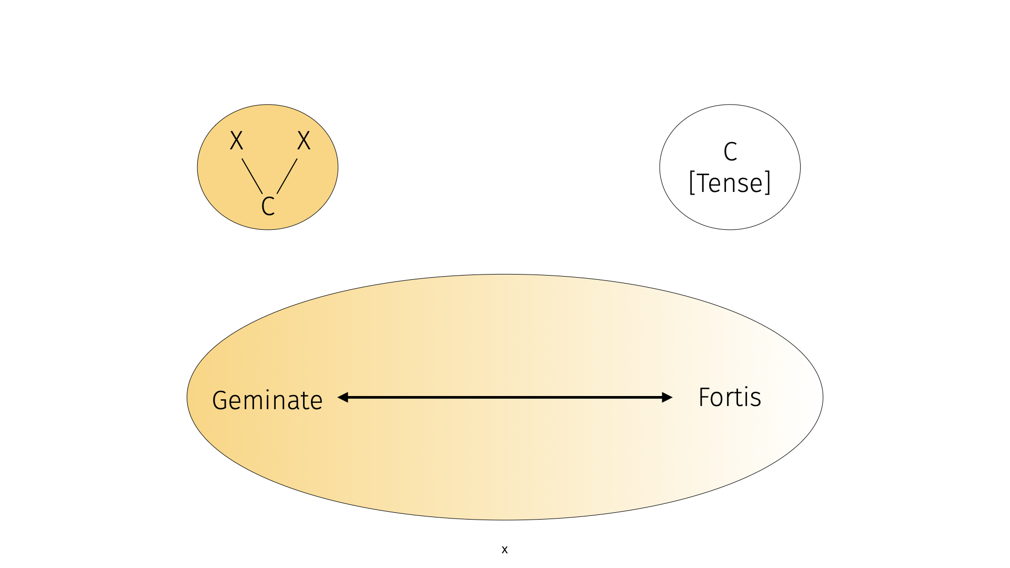
IGs vs fortis are represented as two distinct categories
Initial geminates
Fortis
Notes:
Some might proposed a moraic representation of IGs, but this is out of the scope of this paper

Slide 4
IGs and Fortis: different representations, but same acoustic cues
 | Initial Geminates | Fortis Consonants
Phonological representation | Two timing slots or a mora | Feature(s): [tense] / [constricted glottis] / [stiff]
Acoustic correlates | ↑duration, ↑F0, ↑intensity, ↓spectral tilt, VOT (language dependent) | ↑“articulatory energy”/“resistance” ↑duration, ↑F0, ↑intensity, ↓spectral tilt, VOT (language dependent)
(Trubetzkoy 1939; Jakobson, Fant, Halle 1952; Kohler & Dommelen 1987; Cho et al. 2002; Abramson 2003; Idemaru & Guion 2008; Kraehenmann 2011)
Notes:
Additional correlates (Abramson 2003; Idemaru & Guion 2008)
f0, amplitude, VOT, voice quality
Voiceless stops are most common: surprising because low perceptibility (Kraehenmann 2011)
‘The term tense/lax, strong/weak, fortis/lenis, and so on, should never be loosely and carelessly used without precise phonetic specification’ (Catford 1977)
“Degree of resistance” (Trubetzkoy 1939)
[Tense/lax]: “articulatory energy” (includes vowels) (Jakobson, Fant, Halle 1952)
Correlates overlap with IGs (Kohler & Dommelen 1987, Cho et al. 2002)

Slide 5
A case in point: Korean stops, IGs or fortis?
Korean has a 3-way fortis, lenis, aspirated contrast
[tense] / [constricted glottis] / [stiff] (summarized in Kang, Schertz, & Han forthcoming)
Phonemic geminates with two timing slots (Ahn & Iverson 2004)
Redundant [tense] feature with two timing slots (Han 1996)
Acoustic correlates shared with other IG as well as fortis languages (Lee & Jung 2000)

Slide 6
Our view: IGs & fortis consonants are phonologically unified
Suggested by Ladd & Schmid (2018)
Rich, unified phonological representation where several cues are available to implement phonological contrast
These cues are consistently observed in all languages, but their relative weight is language specific
Geminates are perhaps cases where duration outweighs other cues

Slide 7
3 case studies: Dunan, Pattani Malay & Salentino
Language | IG | Fortis | Other cues
Dunan (Japonic) | ✓ | ✓ | ↓VOT
Pattani Malay (Austronesian) | ✓ |  | ↑F0, ↑intensity
Salentino (Indo-European) | ✓
(Abramson 1998; Romano 2003; Bentley 2008; Yamada et al. 2015)

Slide 8
Two types of data
Controlled data collection: Salentino & Pattani Malay
Salentino: 1 speaker x 14 minimal pairs x 11 repetitions (n = 308), carrier sentence
Pattani Malay: 14 speakers x 13 minimal pairs x 3 repetitions (n = 1,092) elicited using natural sounding Thai sentences to gather a corpus
Opportunistic data collection: Dunan
Dunan: 1 speaker (n = 2,563)
Data from 19 elicitation sessions and stories
Notes:
Data used in this paper are collected with two data collection methods

Slide 9
Measurements and statistical analyses
3 acoustic properties associated with (initial) gemination
Consonant duration (limited to phrase-medial position)
F0 contour of vowel
Intensity contour of vowel
Duration: Linear mixed effects regression
Random effect: consonants
f0, Intensity: 3rd order orthogonal polynomial growth curve analysis
Random effect: vowels
Notes:
Place of articulation and manner

Slide 10
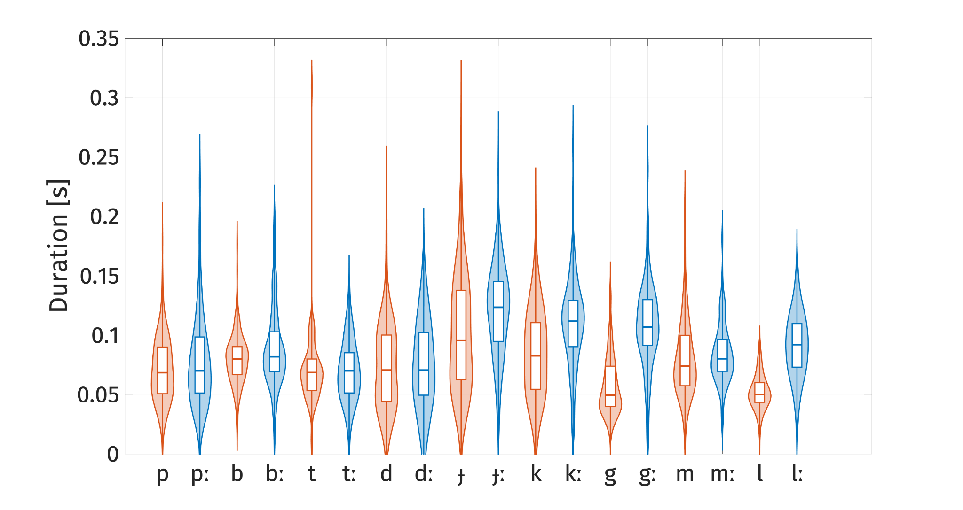
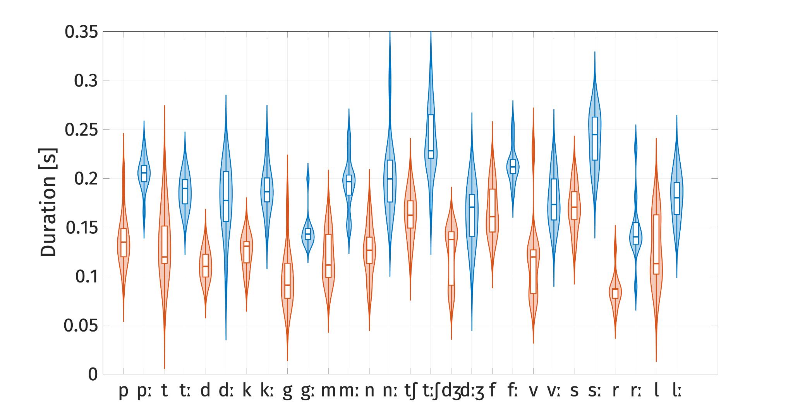
Duration: IGs significantly longer in PM and Salentino
Pattani Malay
Salentino
Notes:
Dunan singleton and IG duration are not significant.
But the magnitude of difference varies, Est. PM: 17 ms., Salentino: 61 ms.,
Note that the duration here includes both closure duration and burst duration for the case of stops

Slide 11
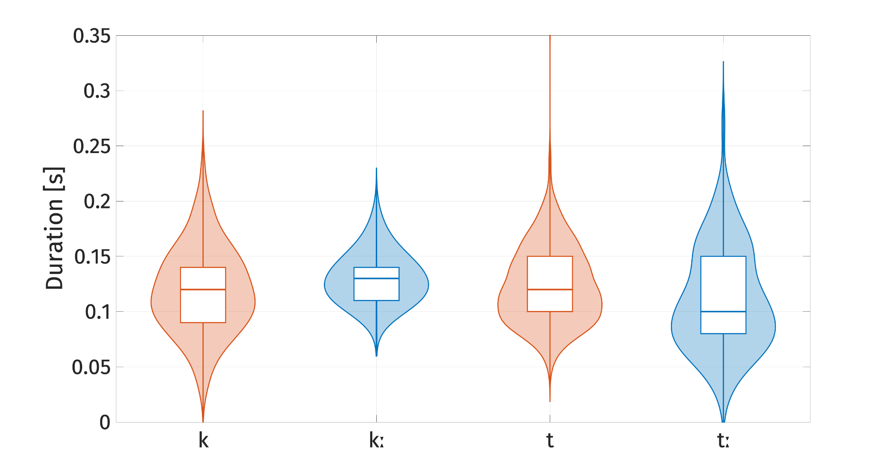
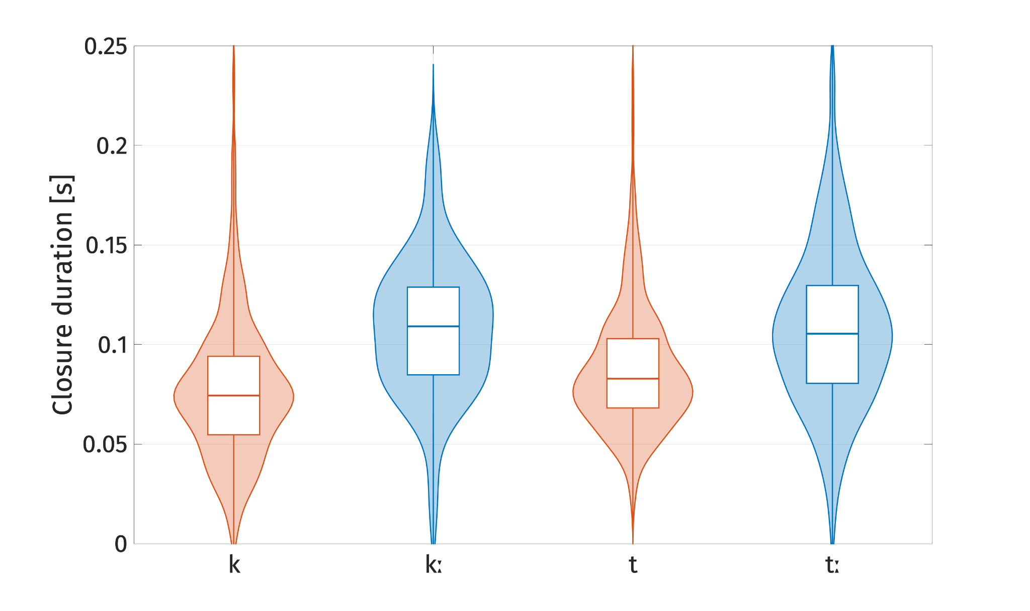
Dunan: IGs have significantly longer closure duration
Closure + burst
Closure only
Notes:
Dunan is a little different, because if we look at the sum of closure duration and burst duration we do not find a significant difference.
For Dunan only the closure duration of IGs are significantly longer.
Recall that in the previous literature IGs in Dunan show shorter positive VOT. This makes it understandable why IGs and singletons so not show difference when we combine the closure duration and burst duration

Slide 12
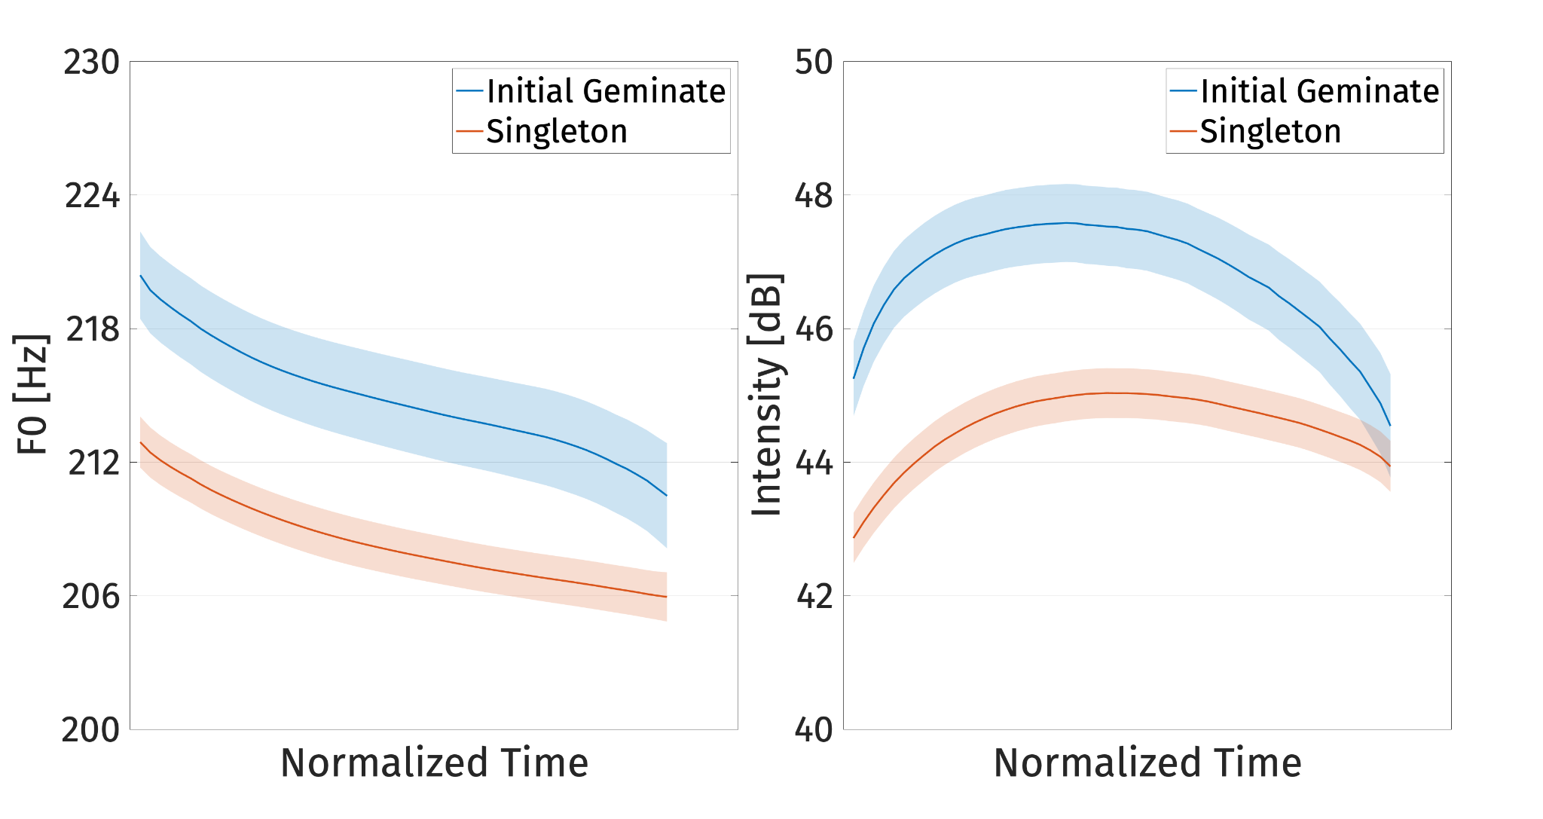
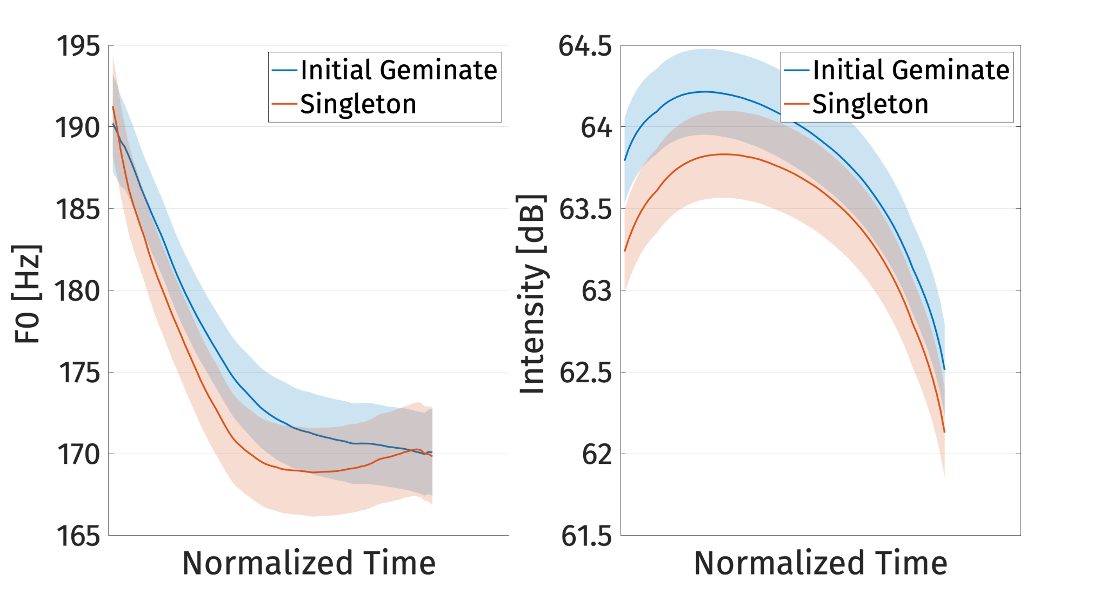
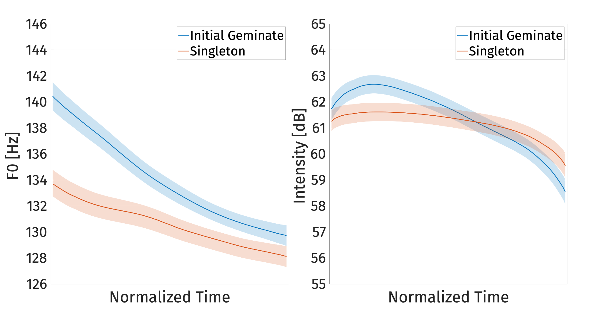
F0 of the following vowel is higher after IGs in all languages
Dunan
Pattani Malay
Salentino
Notes:
f0 of the following vowel is higher after IGs in all languages (p < .001, Est. PM: ~0.2-1.2 Hz; Salentino: 3.5 Hz, Dunan: 5 Hz).
These are the plots of f0 contour over the following vowels
The interactions IG × orthogonal linear time and IG × quadratic time are also significant for PM and Salentino, which shows that the slope and the curvature of the f0 of vowels following IGs are different from the slope and curvature of vowels following singletons (p < .001), while IG × cubic time for PM (p < .05)

Slide 13
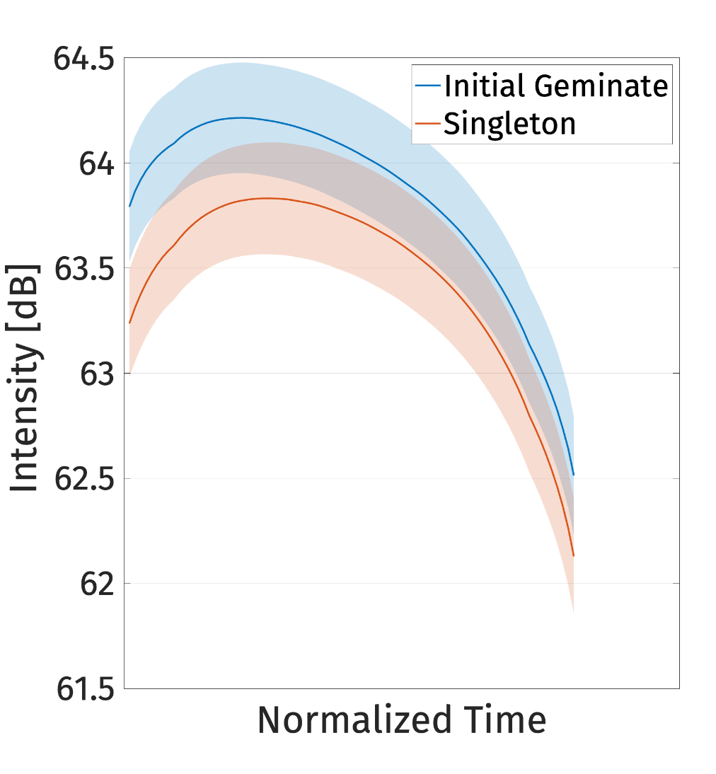
Intensity of the following vowel is higher after IGs
Dunan
Pattani Malay
Salentino
Notes:
Intensity of the following vowel is higher after IGs (p < .001, Est. PM: .39 dB, Salentino: 2.5 dB, Dunan: 2.43 dB)
The interaction of IG × linear time and IG × quadratic time is significant in all languages (p < .05) indicating that the slope and the curvature of intensity after IGs and singletons are also different.
The interaction of IG × cubic is significant in Salentino (p < .001)

Slide 14
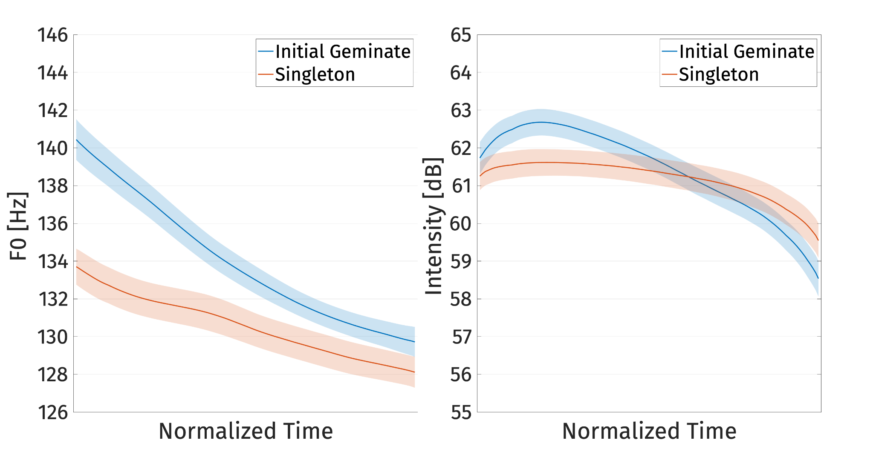
Duration is not the only cue in the production of IGs
F0 and intensity differ much more robustly than generally assumed
Speakers reliably sustain higher F0 and intensity long after release of IGs
Dunan
Pattani Malay
Salentino
Notes:
Interim summary:

Slide 15
Duration is not the only cue in the production of IGs
F0 and intensity differ much more robustly than generally assumed
Speakers reliably sustain higher F0 and intensity long after release of IGs
These long lasting effects are unexpected if they are merely a phonetic effect from long closure duration
Notes:
Interim summary:
Close to the release of the consonant

Slide 16
Cue trade-off: methodology
Hypothesis: as durational differences decrease (longer singletons, shorter geminates), F0 and intensity differences will increase
Method
Pearson R correlation
Mean values of F0 and intensity taken for each token

Slide 17
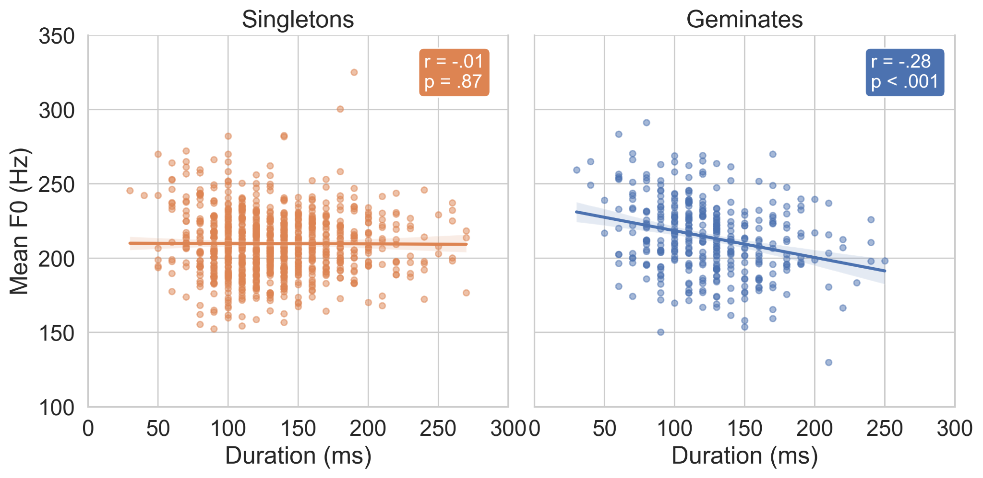
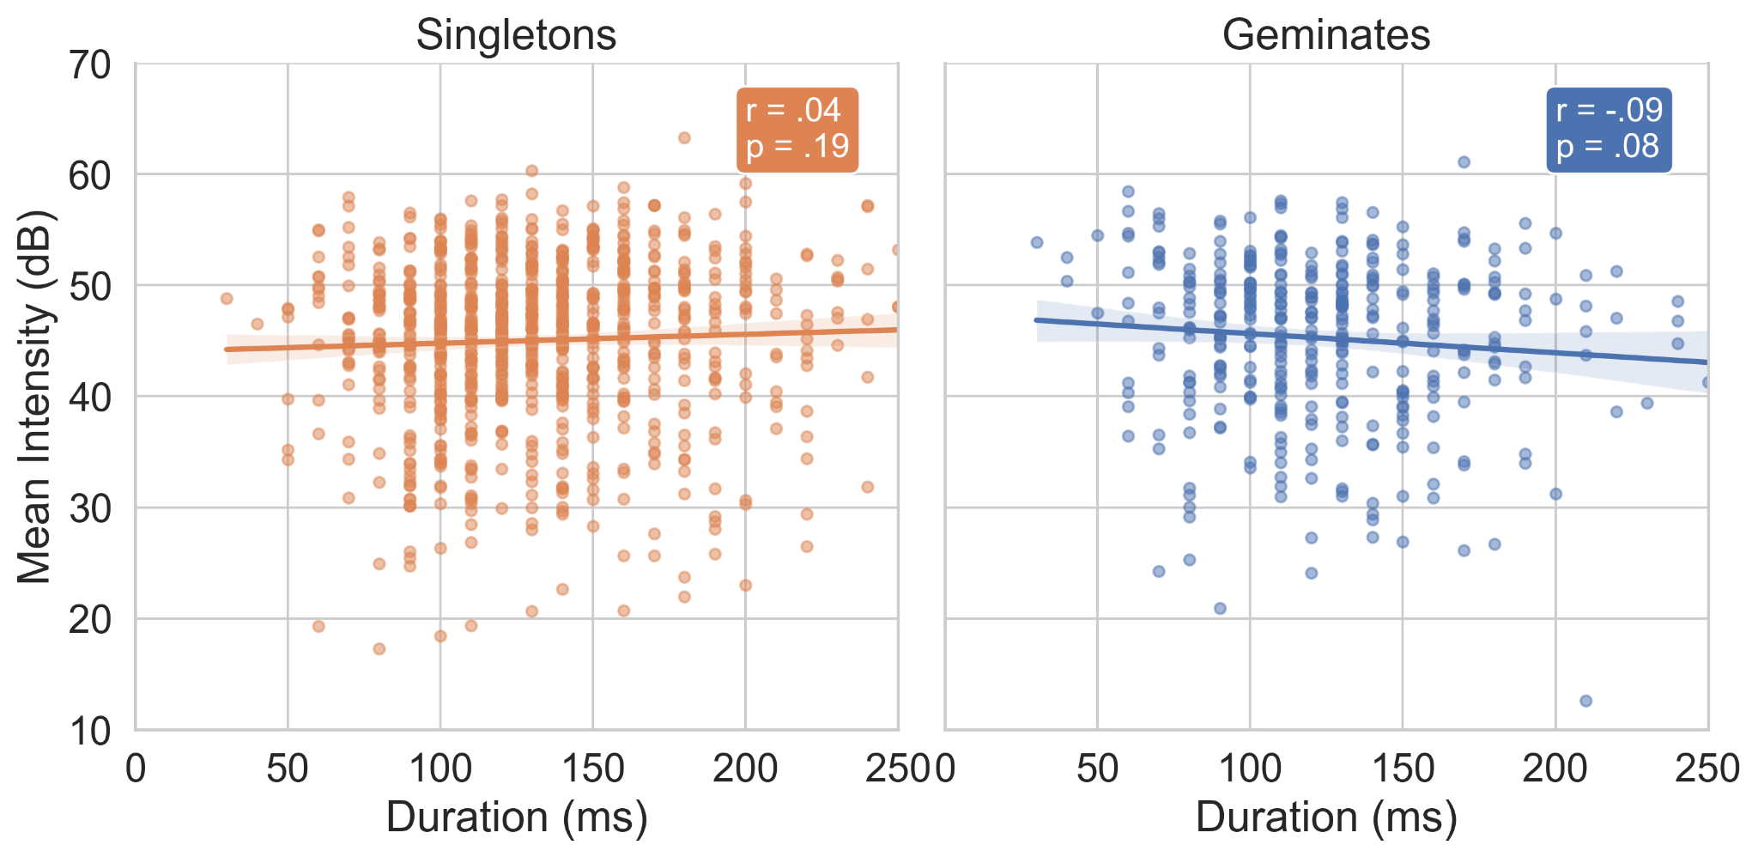
Cue Tradeoff: Dunan
Negative correlation between IG duration & f0
Tradeoff between duration cues and f0 for IGs suggests cue enhancement

Slide 18
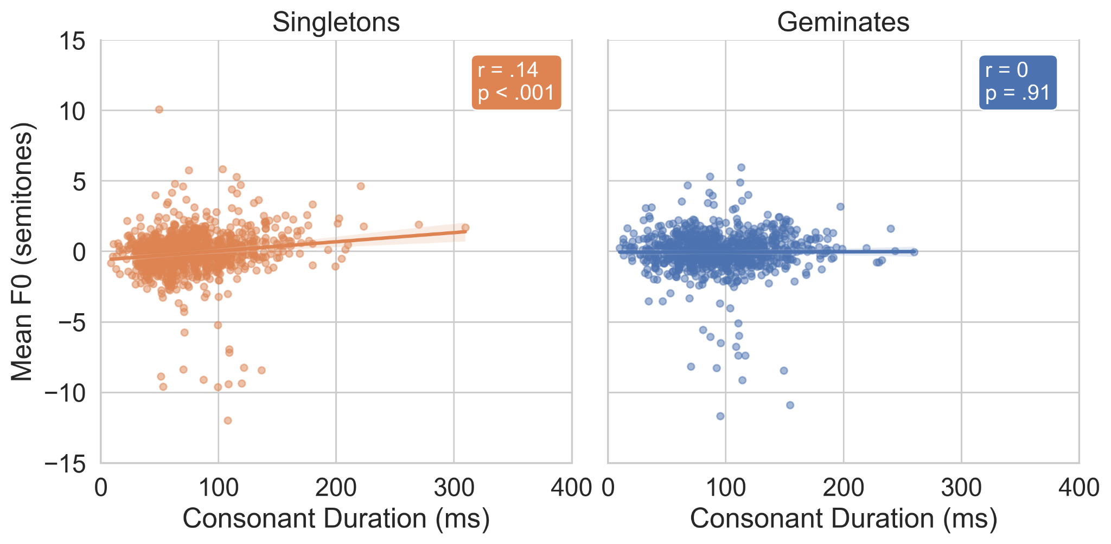
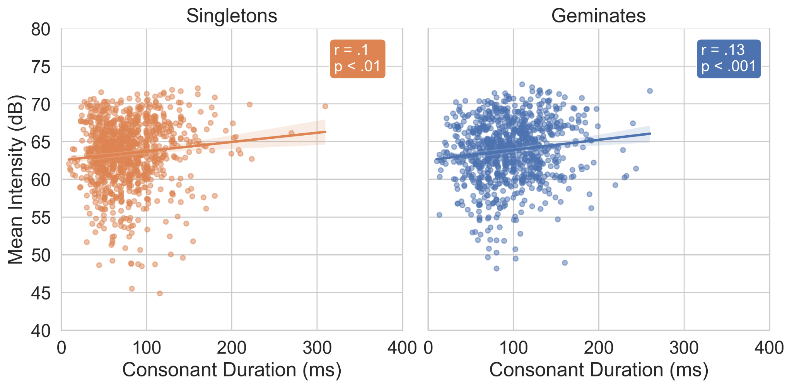
Cue Tradeoff: Pattani Malay
Weak positive correlations

Slide 19
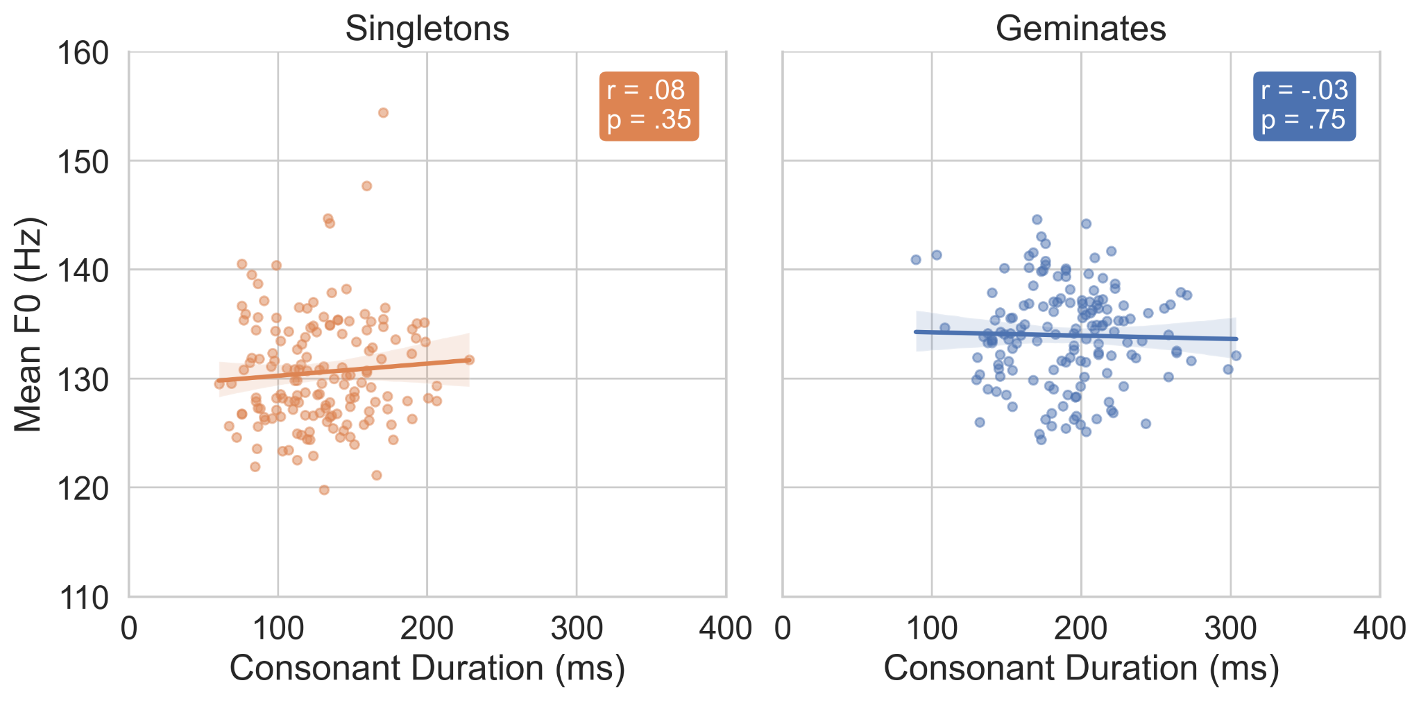
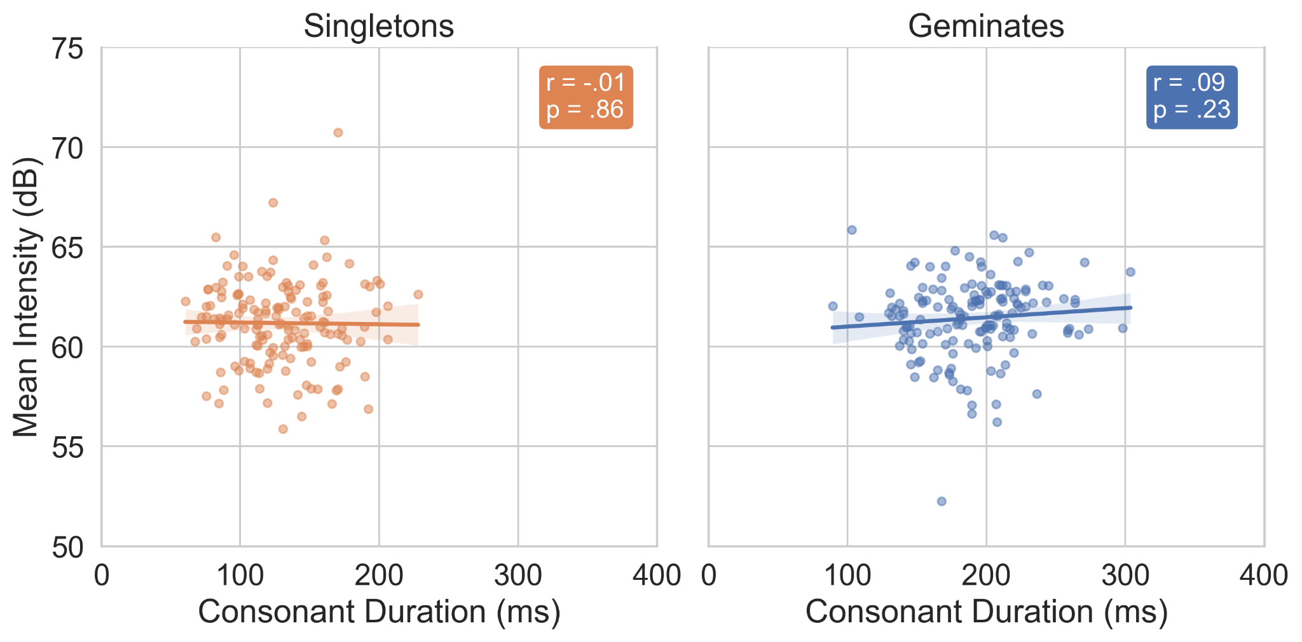
Cue Tradeoff: Salentino
No significant correlations

Slide 20
Machine Learning: Classification
Linear Support Vector Machines (SVM)
Trained on
Duration (Raw, C/σ Ratio)
F0 contours (downsampled to 10 data points)
Intensity contours (downsampled to 10 data points)
Results from a 10-fold cross validation

Slide 21
Dunan Classification
Model | Mean Accuracy | Std Accuracy
Duration + Intensity + F0 | 64.7 % | 1.5 %
Intensity + F0 | 63.4 % | 1.1 %
F0 | 60.8 % | 1.5 %
Duration | 60.7 % | 0.7 %
Intensity | 51.6 % | 1.6 %
Notes:
point out that duration is a poorer cue b/c it includes VOT (duration improves a lot to 72% as a cue if limited to closure duration; whole model is 76.2%)

Slide 22
Pattani Malay Classification
Model | Mean Accuracy | Std Accuracy
Duration + Intensity + F0 | 63.7 % | 0.4 %
Duration | 61.0 % | 0.2 %
Intensity + F0 | 54.0 % | 0.4 %
F0 | 52.8 % | 0.1 %
Intensity | 52.5 % | 0.3 %

Slide 23
Salentino Classification
Model | Mean Accuracy | Std Accuracy
Duration + Intensity + F0 | 81.4 % | 0.6 %
Duration | 77.8 % | 0.4 %
Intensity + F0 | 74.9 % | 1.0 %
F0 | 72.4 % | 0.8 %
Intensity | 71.2 % | 0.9 %

Slide 24
Summary of the results
Same acoustic cues appear in different languages:
F0 & intensity robust and persist over the following vowel
Tradeoff:
Dunan: F0 trades off with duration
No significant correlation in Pattani Malay and Salentino
Classification:
duration + F0 + intensity always perform better than models with each cue alone
PM and Salentino: duration > F0 ~ intensity
Dunan: F0 ~ duration > intensity (with VOT included)

Slide 25
A single feature [+long] or two timing slots are insufficient characterizations of IGs
Potentially capture intensity or F0 differences close to the release of the consonant
But not the sustained higher F0 and intensity long after the release

Slide 26
Constellation of cues capturing a natural class (IGs) related to various (supra)laryngeal activities
Longer duration, higher F0 and intensity targets
Not unlike register, which also involves a bundle of cues
Cf. emergent features from acoustic cues (Mielke 2008)
“Fortis”
[±spread glottis]
[±long]
[±voice]
[±constricted glottis]
Notes:
Support for unification of fortis/IGs by Ladd & Schmid (2018)
Details differ by language depending on relative weight of cues
Greater weighting of duration associated with geminates

Slide 27
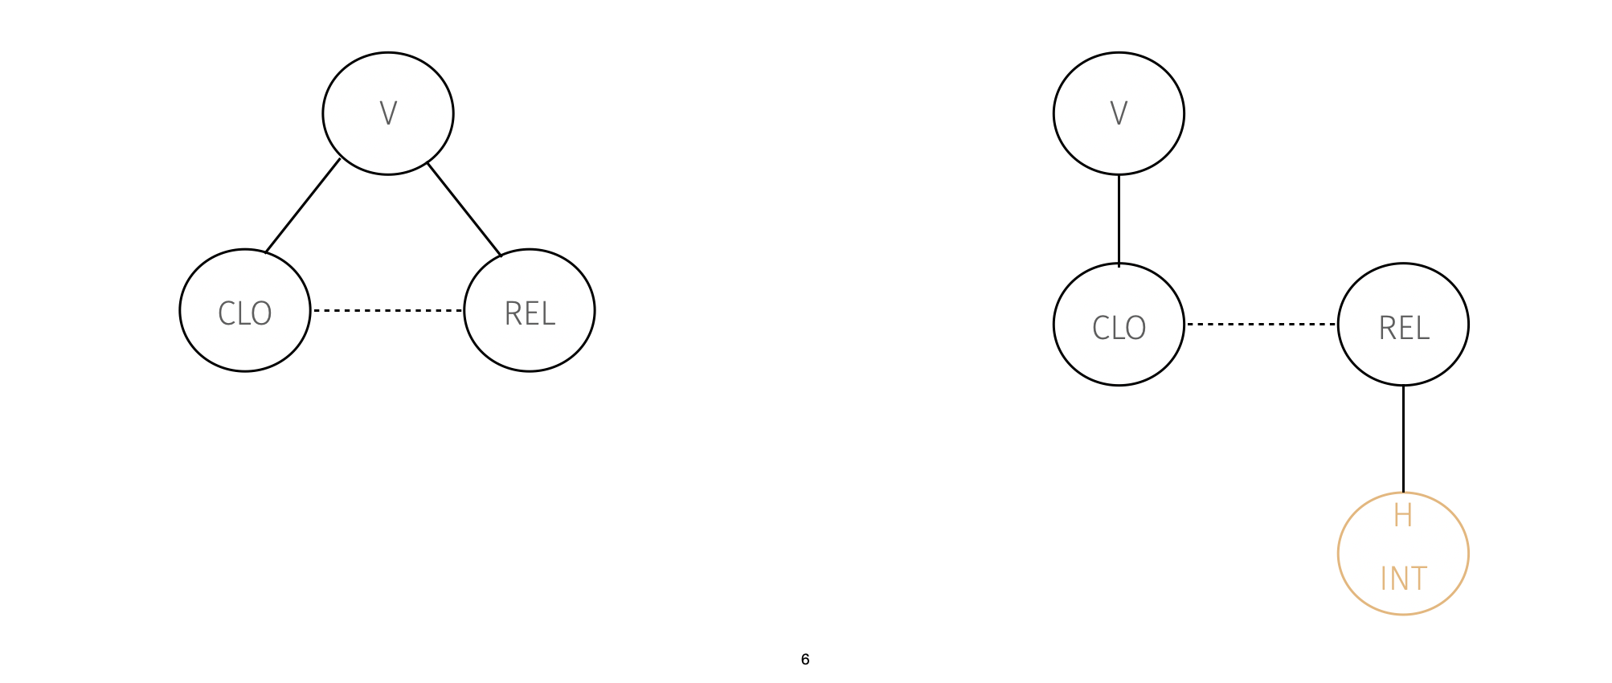
An Articulatory Phonology representation: coupling graphs

Slide 28
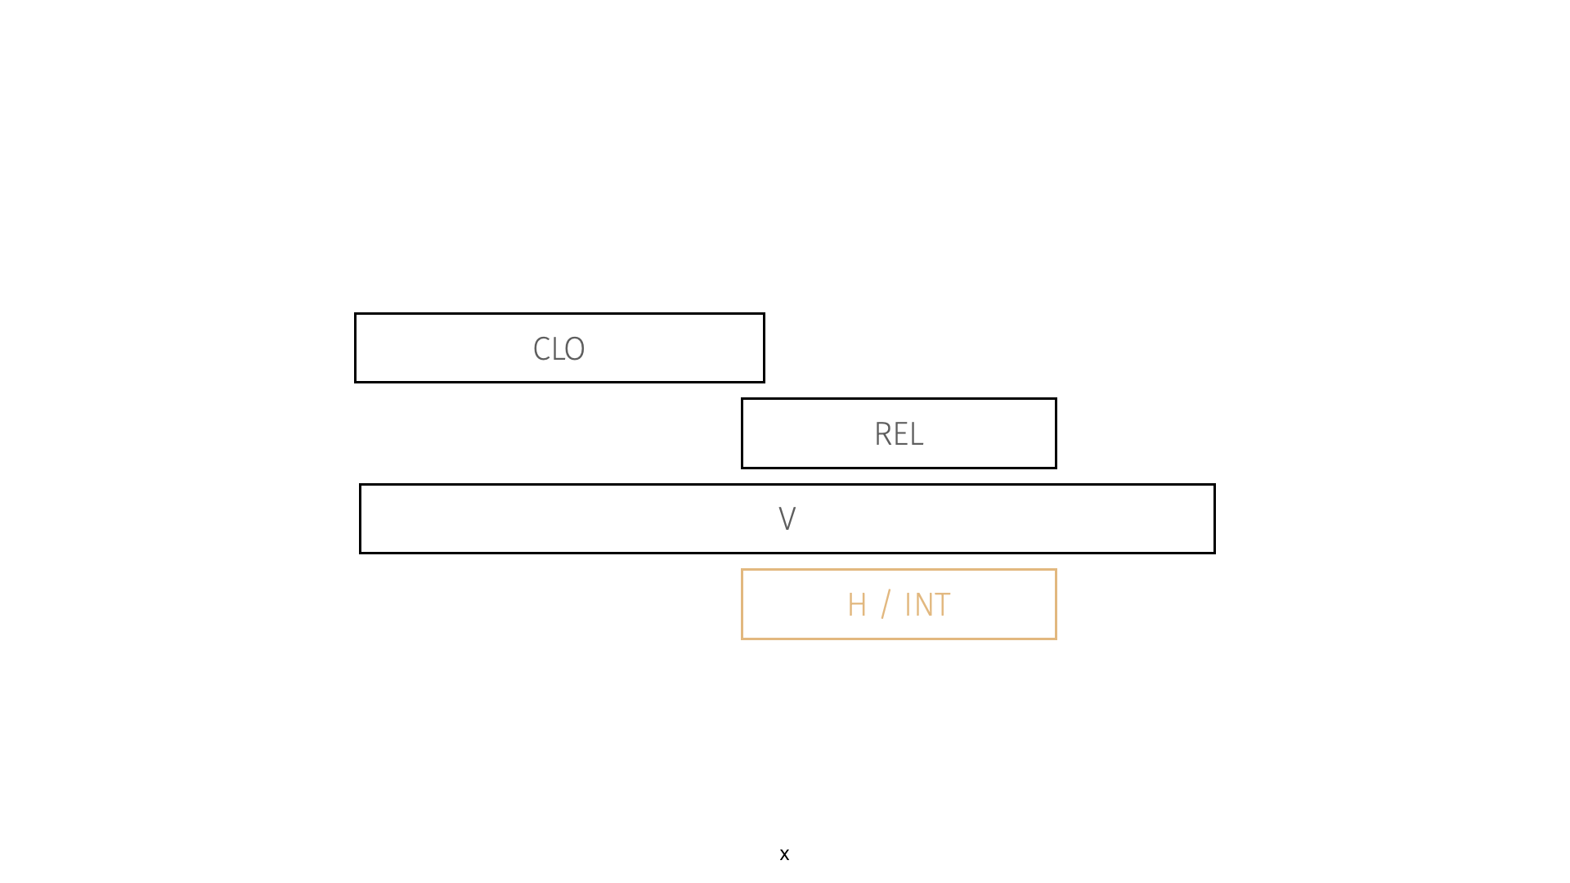
IGs are associated with H and INT(ensity) gestures

Slide 29
Conclusions
Even for “prototypical geminates”, F0/Intensity are more than just “auxiliary”
Our results show great overlap between cues for IGs and fortis consonants
Representation
Phonologically, constellation of possible phonological specifications (“fortis-like”)
IGs show greater weighting and less variability of durational cues
These findings can explain some typologically surprising facts:
Voiceless IGs are common, but they are also the hardest to perceive. F0 and Intensity may come into play
To our knowledge no language has both IGs and fortis stops
Notes:
Several cues -> overlap with fortis
Same phonological representation

Slide 30
Thank you!
We would like to thank our Dunan, Pattani Malay, and Salentino consultants for providing their time to work with us, the members of the Cornell Phonetics Lab and UC Berkeley’s Phorum, Bob Ladd, Susan Lin, Pittayawat Pittayaporn, and three anonymous reviewers for comments on our work, and Pimthip Kochaiyaphum for help in collecting data from Pattani Malay consultants.

Slide 31
Bonus Slides
Notes:
Correlation on other direction:
Causal priority -> predict
Mediation analysis
Different relationships in other languages

Slide 32
Dunan IGs
 |  | Labial |  | Dental |  | Palatal |  | Velar |  | Glottal
stop | voiceless |  | pː | t | tː |  | cː | k | kː
 | voiced | b |  | d |  |  |  | g
fricative |  |  |  | s |  |  |  |  |  | h
nasal |  | m | mː | n | nː |  |  | ŋ | ŋː
tap/trill |  |  |  | r
glide |  | w |  |  |  | j

Slide 33
Pattani Malay IGs
 |  | Labial |  | Alveolar |  | Palatal |  | Velar |  | Glottal
stop | voiceless | p | pː | t | tː | c | cː | k | kː | ʔ | ʔː
 | voiceless aspirated | p^{h} | pː^{h} | t^{h} | tː^{h} | c^{h} | cː^{h} | k^{h} | kː^{h}
 | voiced | b | bː | d | dː | ɟ | ɟː | g | gː
fricative | voiceless |  | (fː) | s | sː |  |  |  | (xː) | h | hː
 | voiced |  |  |  | zː |  |  | ɣ | ɣː
nasal |  | m | mː | n | nː | ɲ | ɲː | ŋ | ŋː
lateral |  |  |  | l | lː
trill |  |  |  |  | rː
glide |  | w | wː |  |  | j | jː

Slide 34
Salentino IGs
 |  | Labial |  | Alveolar |  | Palatal |  | Velar
stop | voiceless | p | pː | t | tː |  |  | k | kː
 | voiced |  | bː | d | dː |  |  | g | gː
fricative | voiceless | f | fː | s | sː
 | voiced | v | vː | (z) |  |  | ʃː
affricate | voiceless |  |  | ts |  | tʃ | tʃː
 | voiced |  |  | dz |  | dʒ | dʒː
nasal |  | m | mː | n | nː |  | ɲː | ŋ
lateral |  |  |  | l | lː |  | ʎː
trill |  |  |  | r | rː
glide |  | w |  |  |  | j

Slide 35
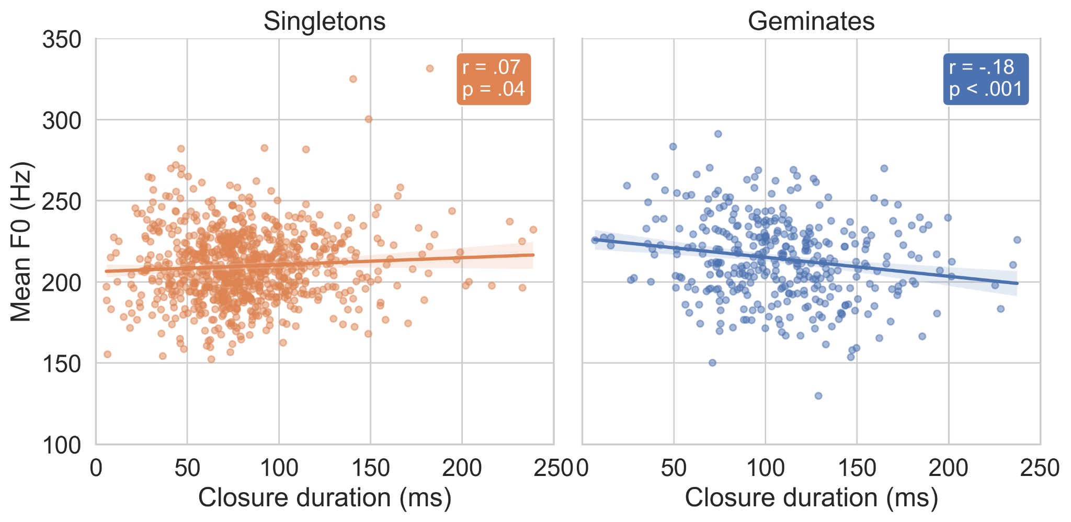
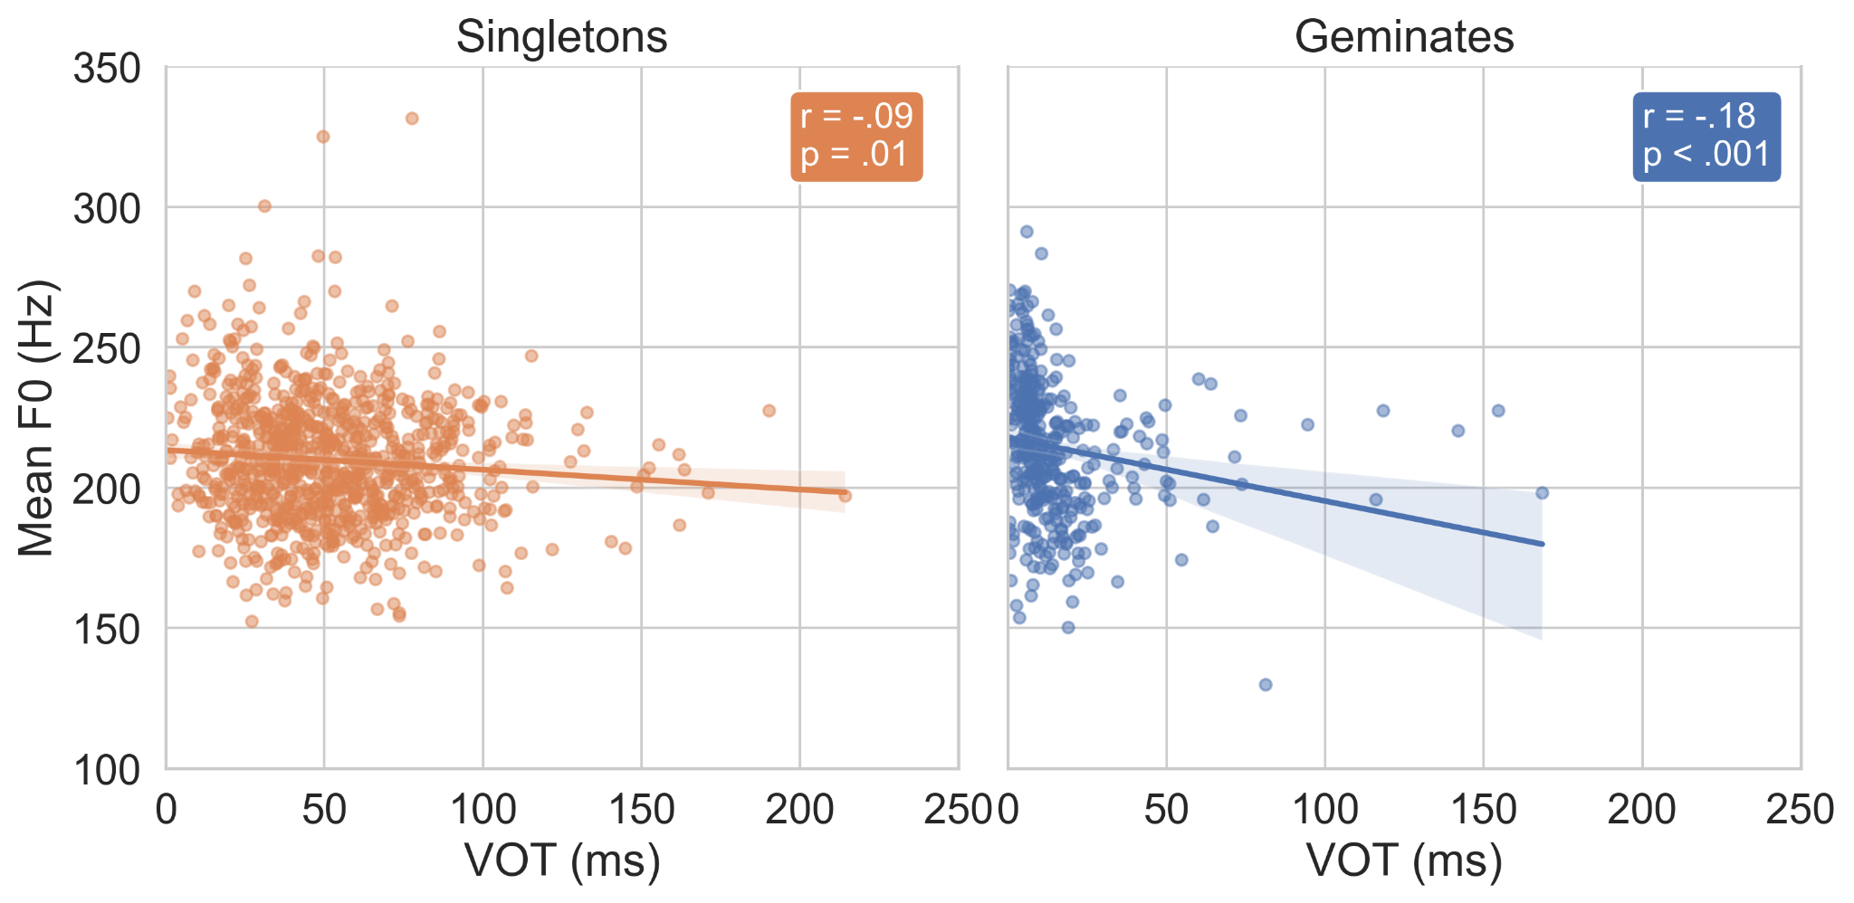
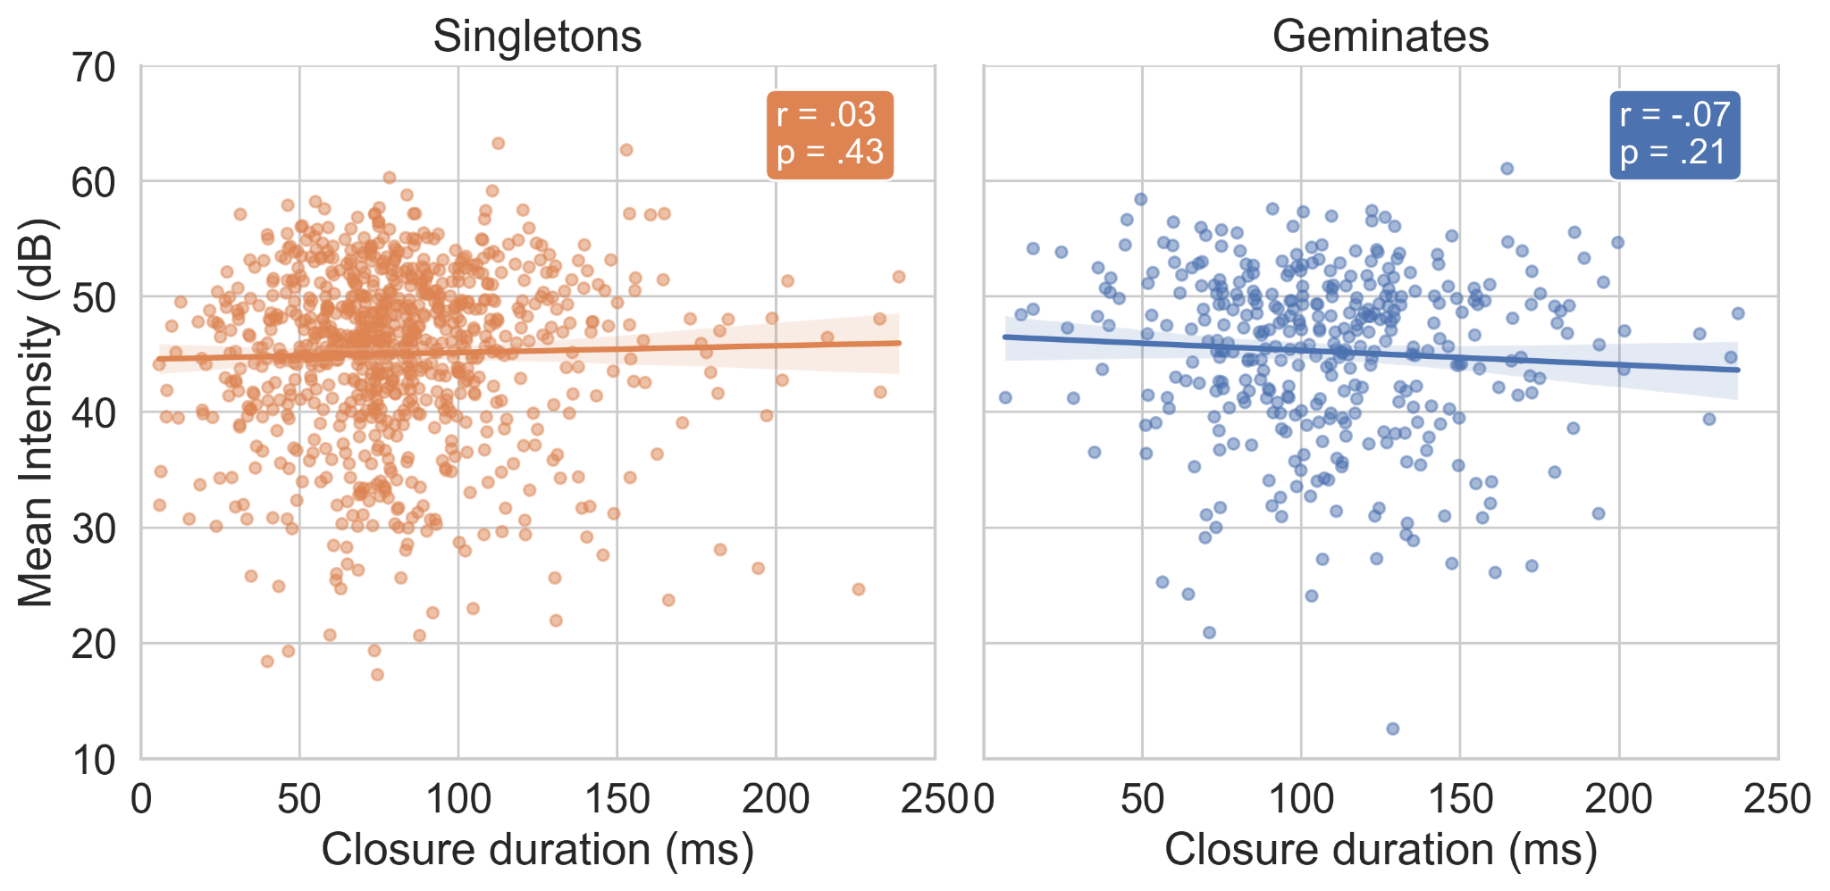
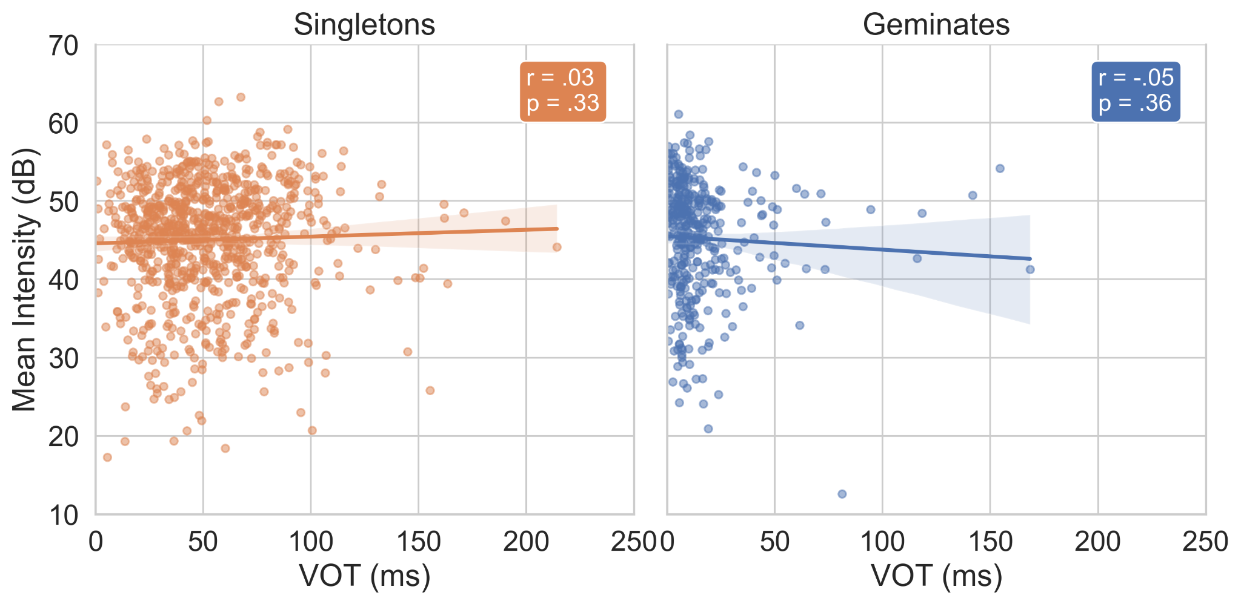
Dunan closure duration & VOT comparisons

Slide 36
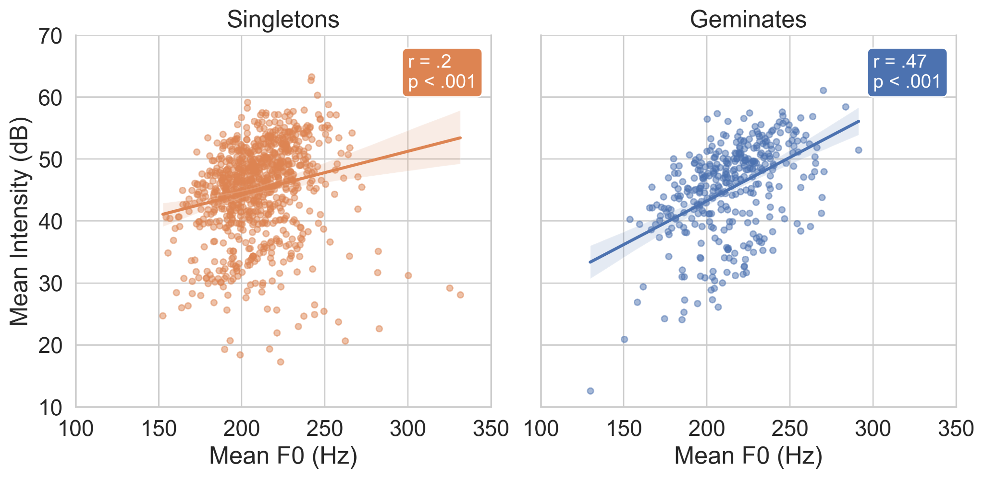
Dunan f0-intensity

Slide 37
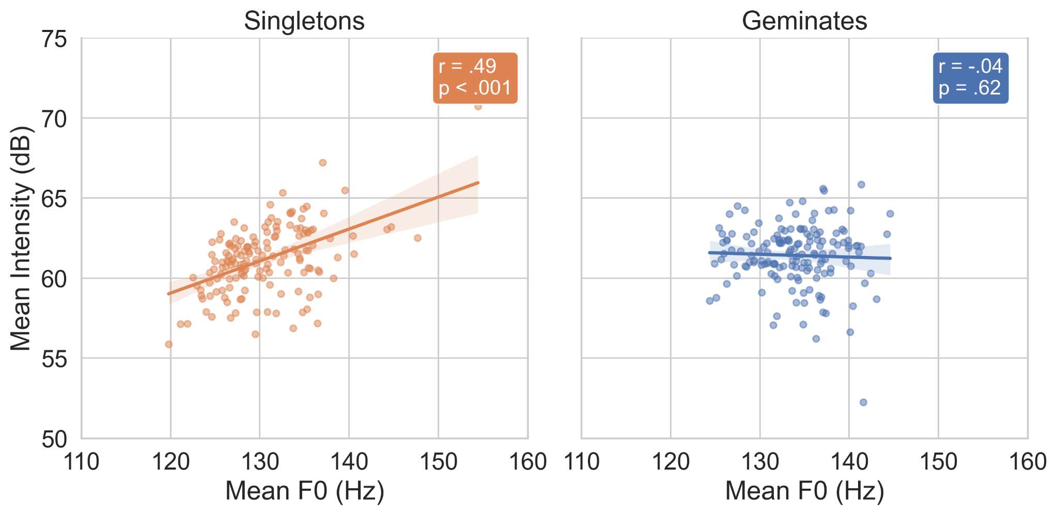
Salentino f0-intensity

Slide 38
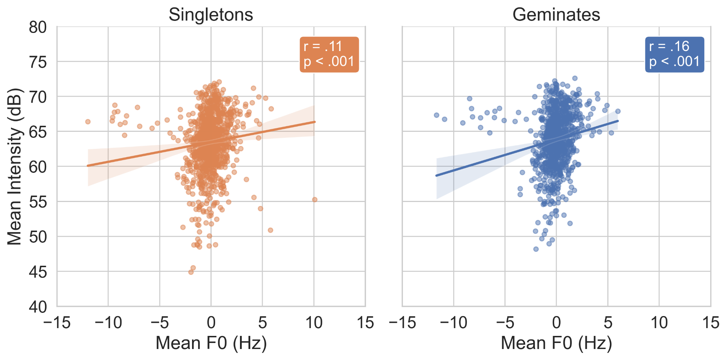
Pattani Malay f0-intensity

Slide 39
Dunan Classification* (closure duration only)
Model | Mean Accuracy | Std Accuracy
Duration + Intensity + F0 | 76.2 % | 0.5 %
Duration | 72.0 % | 0.4 %
Intensity + F0 | 59.1 % | 0.7 %
F0 | 52.7 % | 0.5 %
Intensity | 51.7 % | 1.1 %
Notes:
Only for closure duration

Slide 40

Recordings of Dunan
/tui/ ‘bird’ /ttui/ ‘one person’

Slide 41
Recordings of Pattani Malay
buŋɔ ‘flower’ vs bbuŋɔ ‘to bloom’
“The flower blooms”

Slide 42
Recordings of Salentino
sulu
ssulu
‘alone’
‘to separate’

